Slide 1

Design of Protective Water Barrier Pillars for Enhanced Safety and Productivity in Underground Coal Mines
A Galav, G S P Singh, S K Sharma
Department of Mining Engineering, IIT(BHU) Varanasi

Slide 2
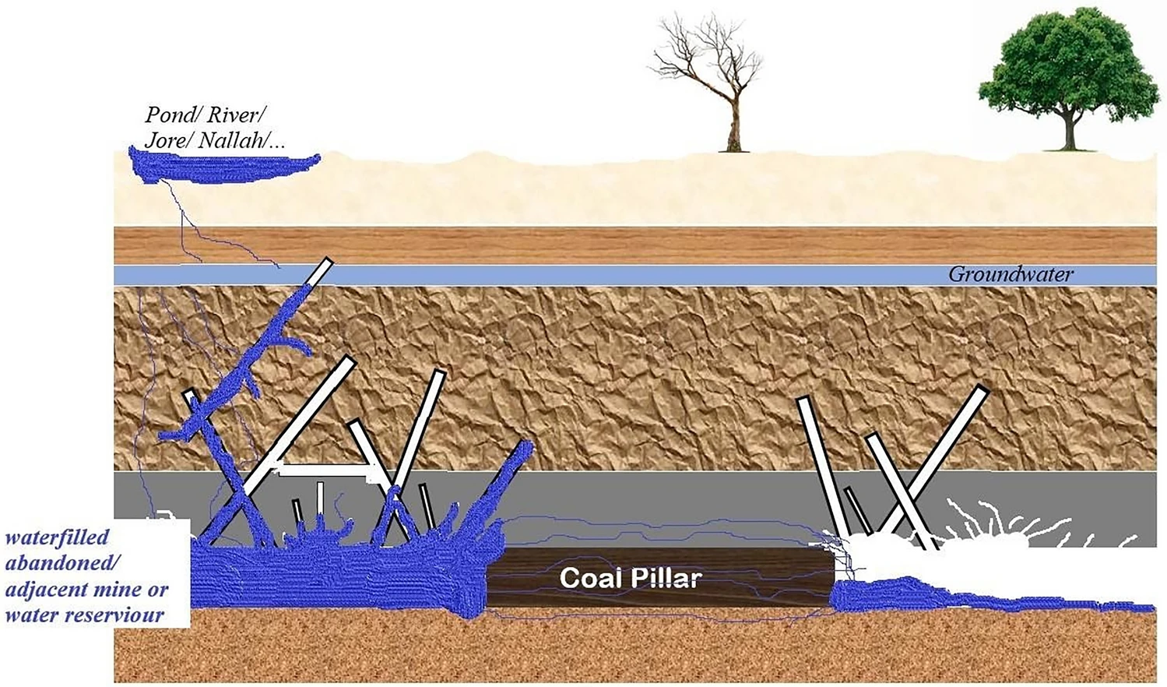
Introduction
A number of underground coal mines in India are facing the threat of a variety of high risk hazards including inundation from waterlogged workings, mainly due to inaccurate design.
Seepage and sudden inrush of water in an active mine working in the vicinity of a waterlogged old workings is a major concern for safety and economy of coal production.
Providing a suitable size of protective water barrier pillar is a predominant practice for protection against such a danger.

Slide 3
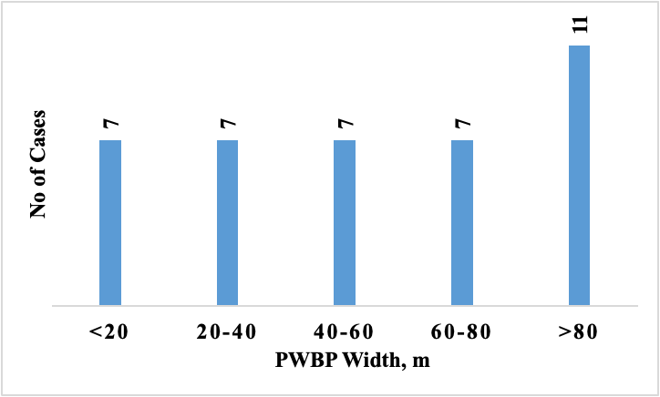
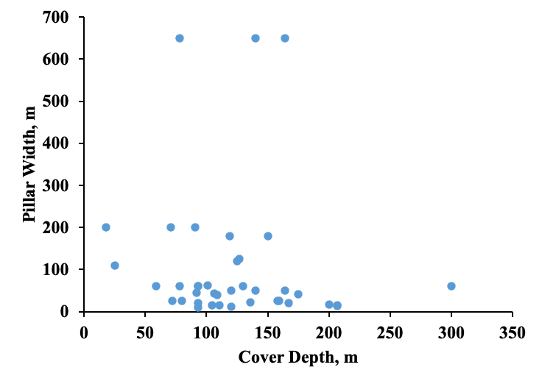
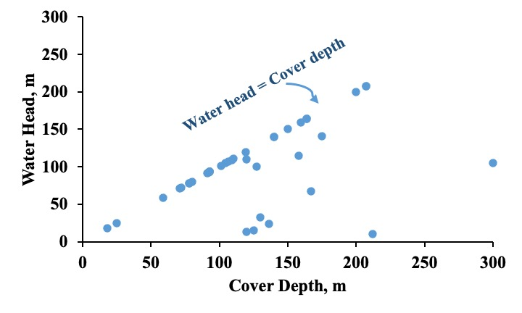
Field Survey

Slide 4
Objective
The main objective of this work was to develop scientific criteria and guidelines for the design of protective water barrier pillars (PWBP) for different geo-mining conditions considering the different strength and flow regimes.
The collateral objectives of the work were to:
• examine the mechanisms of loading and failure of PWBP
• develop an understanding of mechanical and hydraulic performance of PWBP with the change in water head, and
• to assess the rational size of barrier pillar width for different geo-mining conditions

Slide 5
Literature Review
Researchers | Findings
Singh (1982) | noted that adequate provision for permeability and high water head should be considered while designing pillars in a hydro-mechanical interaction environment.
Kesseru (1982) | attempted the design of a protective water barrier pillar for constant permeability. The determination of the hydraulic gradient and consideration of the yield zone in the pillar is important. The minimum size of the pillar was determined considering the actual hydraulic gradient equal to the critical hydraulic gradient.
McCoy et al. (2004) | studied the leakage rate across coal mine barriers of 15 to 50 m width. The leakage across the barrier was determined considering the horizontal hydraulic conductivity of the coal seam, the thickness of the barrier, head difference, and orientation of the barrier with respect to cleavage planes in the coal wall.
Kendorski & Bunnell (2007) | a coupled numerical simulation using a two-dimensional finite difference approach to estimate induced strain and flow characteristics in the water barrier pillars. They concluded that the rock behaved elastically without any significant change in the flow pathway below the threshold strain of 0.1%. Accordingly, the study evaluated the coal pillar of 107 m width at a cover depth of 580 m as low geotechnical but moderate hydrological risk.
Meng et al. (2016) | proposed a three-dimensional coupled approach that revealed that permeability distribution in a structure varies with the constitutive behaviour. Primary pores get closed during elastic deformation but increase rapidly after crossing the peak strength. As the interstice dimensions in a coal seam are minimal, the fluid flow is laminar in such case.
Chen (2017) | considered coupled simulation to analyse hydraulic pressure and seepage rate and suggested a 30.7 m wide pillar at 509 m depth.

Slide 6
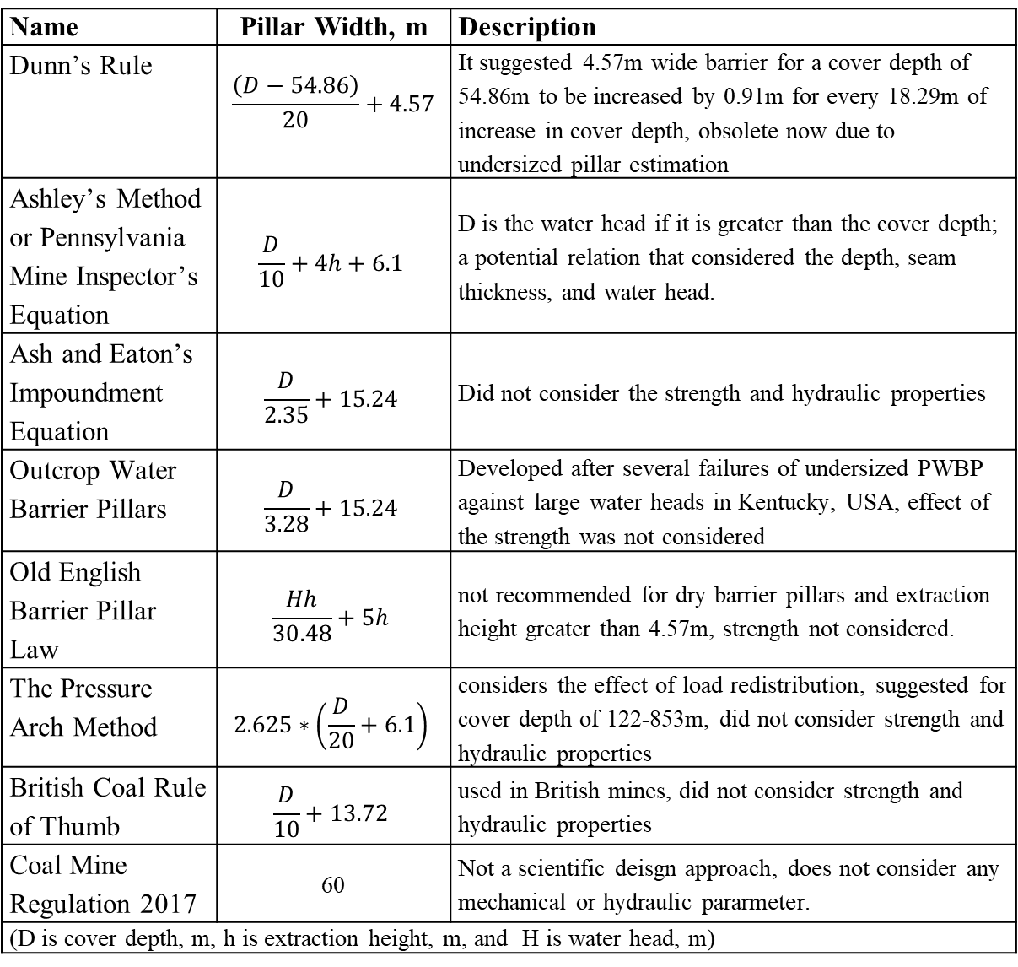
Name | Pillar Width, m | Description
Dunn’s Rule | $$\frac{\left(D−54.86\right)}{20}+4.57$$ | It suggested 4.57m wide barrier for a cover depth of 54.86m to be increased by 0.91m for every 18.29m of increase in cover depth, obsolete now due to undersized pillar estimation
Ashley’s Method or Pennsylvania Mine Inspector’s Equation | $$\frac{D}{10}+4h+6.1$$ | D is the water head if it is greater than the cover depth; a potential relation that considered the depth, seam thickness, and water head.
Ash and Eaton’s Impoundment Equation | $$\frac{D}{2.35}+15.24$$ | Did not consider the strength and hydraulic properties
Outcrop Water Barrier Pillars | $$\frac{D}{3.28}+15.24$$ | Developed after several failures of undersized PWBP against large water heads in Kentucky, USA, effect of the strength was not considered
Old English Barrier Pillar Law | $$\frac{Hh}{30.48}+5h$$ | not recommended for dry barrier pillars and extraction height greater than 4.57m, strength not considered.
The Pressure Arch Method | $$2.625∗\left(\frac{D}{20}+6.1\right)$$ | considers the effect of load redistribution, suggested for cover depth of 122-853m, did not consider strength and hydraulic properties
British Coal Rule of Thumb | $$\frac{D}{10}+13.72$$ | used in British mines, did not consider strength and hydraulic properties
Coal Mine Regulation 2017 | 60 | Not a scientific deisgn approach, does not consider any mechanical or hydraulic pararmeter.
(D is cover depth, m, h is extraction height, m, and H is water head, m)
Existing methods
lack reliability of the findings
essential to revisit the prevailing design approach
The methods developed elsewhere result into either over or under estimation
focus on the mechanical performance and ignore hydraulic performance (Kendorski, 2007)
In most countries, modern legislation has changed requiring scientific understanding based norms

Slide 7
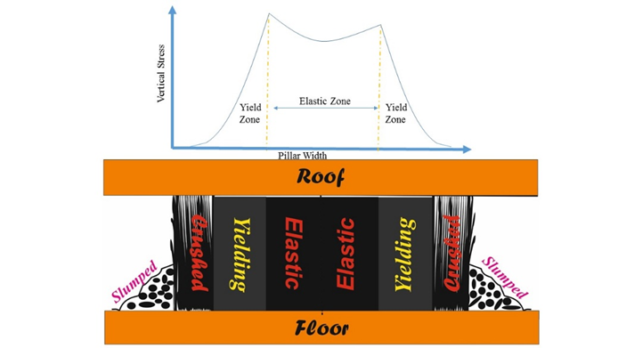
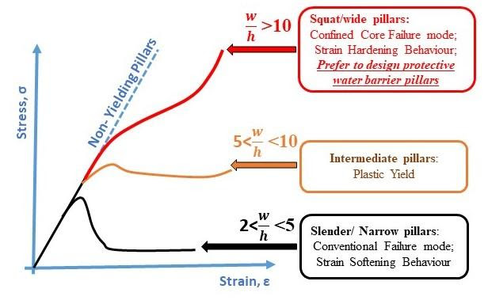
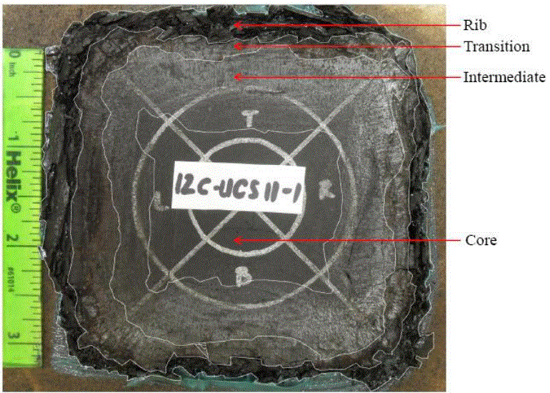

Slide 8
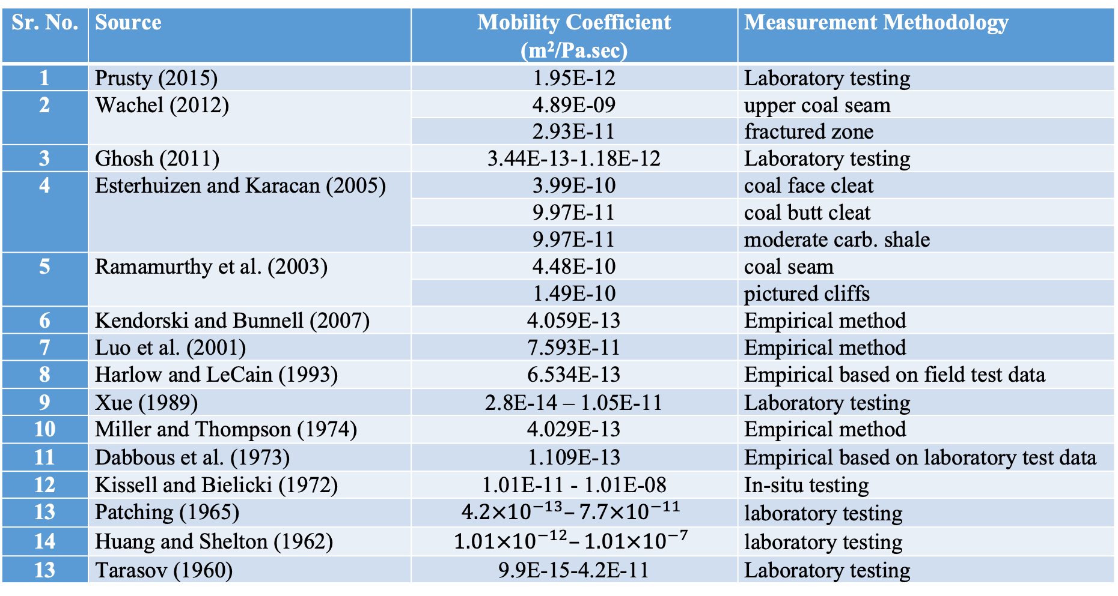
Mobility coefficient of coal
Sr. No. | Source | Mobility Coefficient (m²/Pa.sec) | Measurement Methodology
1 | Prusty (2015) | 1.95E-12 | Laboratory testing
2 | Wachel (2012) | 4.89E-09 | upper coal seam
 |  | 2.93E-11 | fractured zone
3 | Ghosh (2011) | 3.44E-13-1.18E-12 | Laboratory testing
4 | Esterhuizen and Karacan (2005) | 3.99E-10 | coal face cleat
 |  | 9.97E-11 | coal butt cleat
 |  | 9.97E-11 | moderate carb. shale
5 | Ramamurthy et al. (2003) | 4.48E-10 | coal seam
 |  | 1.49E-10 | pictured cliffs
6 | Kendorski and Bunnell (2007) | 4.059E-13 | Empirical method
7 | Luo et al. (2001) | 7.593E-11 | Empirical method
8 | Harlow and LeCain (1993) | 6.534E-13 | Empirical based on field test data
9 | Xue (1989) | 2.8E-14 – 1.05E-11 | Laboratory testing
10 | Miller and Thompson (1974) | 4.029E-13 | Empirical method
11 | Dabbous et al. (1973) | 1.109E-13 | Empirical based on laboratory test data
12 | Kissell and Bielicki (1972) | 1.01E-11 - 1.01E-08 | In-situ testing
13 | Patching (1965) | $$4.2×{10}^{−13}–7.7×{10}^{−11}$$ | laboratory testing
14 | Huang and Shelton (1962) | $$1.01×{10}^{−12}–1.01×{10}^{−7}$$ | laboratory testing
13 | Tarasov (1960) | 9.9E-15-4.2E-11 | Laboratory testing
k(in m2 (Pa ·s) −1)= = k(in mD) x 9.90E-13

Slide 9
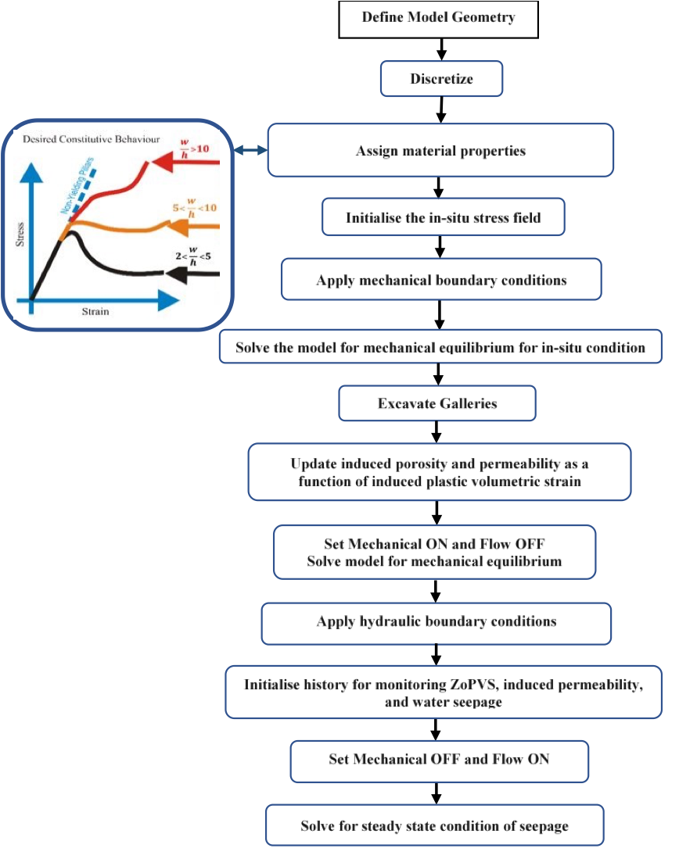
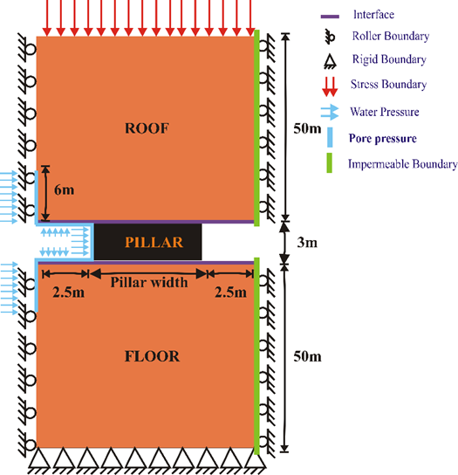
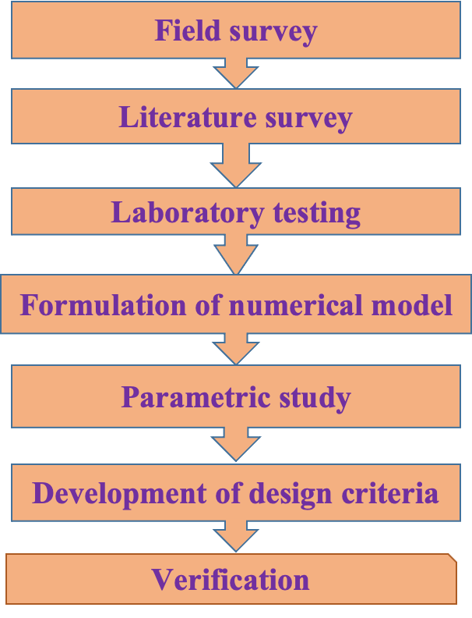
Research Methodology

Slide 10
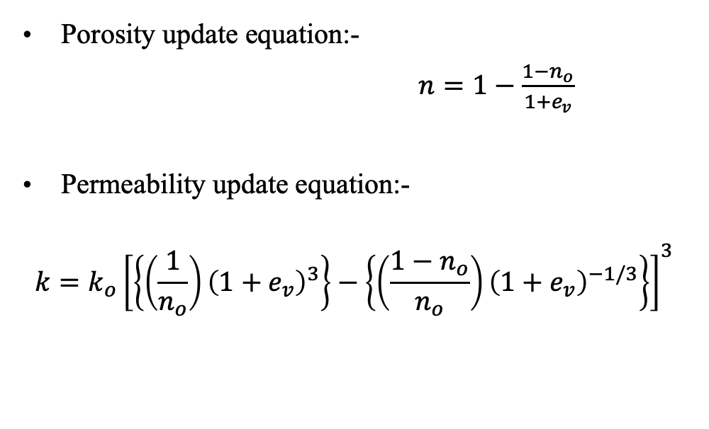
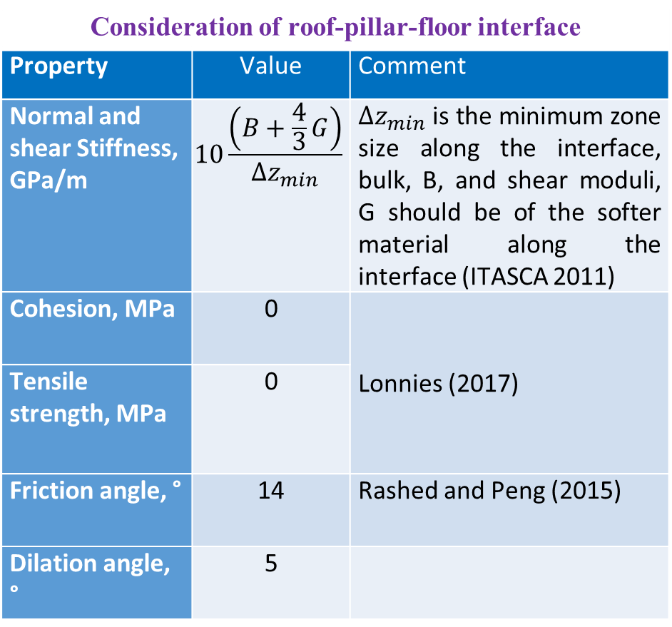
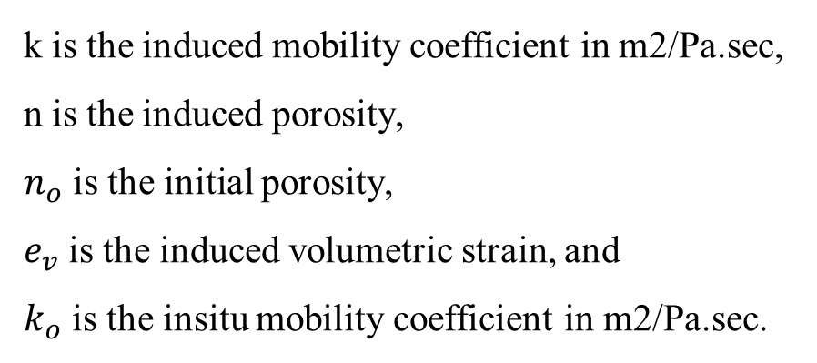
Consideration of roof-pillar-floor interface
Property | Value | Comment
Normal and shear Stiffness, GPa/m | $$10\frac{\left(B+\frac{4}{3}G\right)}{∆z_{min}}$$ | $∆z_{min}$ is the minimum zone size along the interface, bulk, B, and shear moduli, G should be of the softer material along the interface (ITASCA 2011)
Cohesion, MPa | 0 | Lonnies (2017)
Tensile strength, MPa | 0
Friction angle, ° | 14 | Rashed and Peng (2015)
Dilation angle, ° | 5
Induced porosity and permeability as induced plastic volumetric strain
k is the induced mobility coefficient in m2/Pa.sec,
n is the induced porosity,
$n_{o}$ is the initial porosity,
$e_{v}$ is the induced volumetric strain, and
$k_{o}$ is the insitu mobility coefficient in m2/Pa.sec.

Slide 11
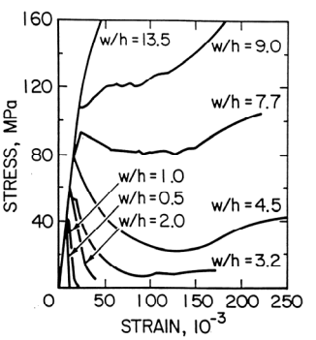
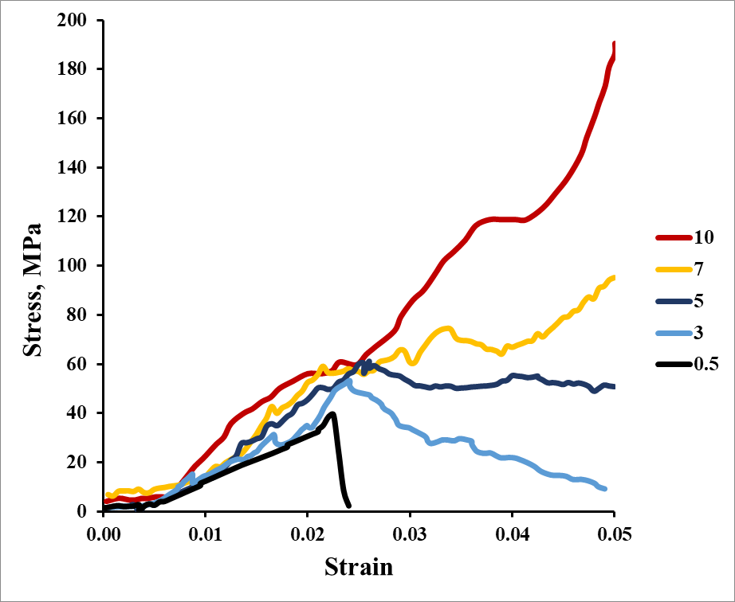
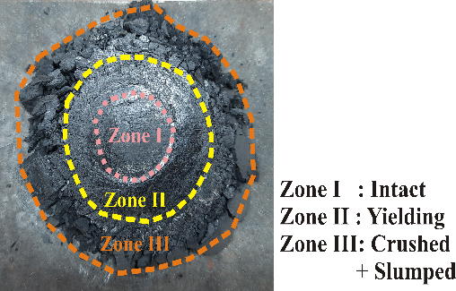

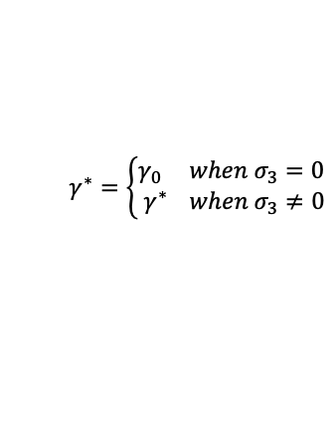

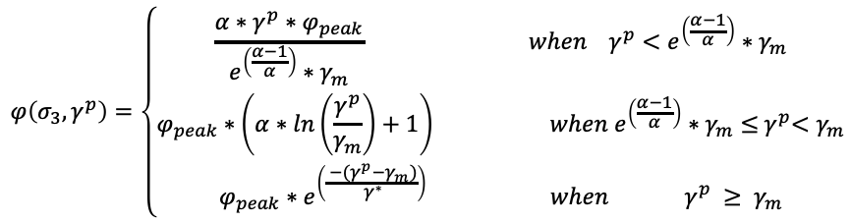

Simulation of the Strain-Softening Behaviour
$$φ\left(σ_{3},γ^{p}\right)=\left\{\begin{aligned}\frac{α∗γ^{p}∗φ_{peak}}{e^{\left(\frac{α−1}{α}\right)}∗γ_{m}} when{ γ}^{p}<e^{\left(\frac{α−1}{α}\right)}∗γ_{m} \\ φ_{peak}∗\left(α∗ln\left(\frac{γ^{p}}{γ_{m}}\right)+1\right) when e^{\left(\frac{α−1}{α}\right)}∗γ_{m}≤{ γ}^{p}<γ_{m} \\ φ_{peak}∗e^{\left(\frac{{ −(γ}^{p}−γ_{m})}{{ γ}^{∗}}\right)} when { γ}^{p} ≥ γ_{m}\end{aligned}\right.$$
$α=α_{0}+α^{′}∗$ $σ_{3}$
$$γ^{∗}=\left\{\begin{aligned}γ_{0} when σ_{3}=0 \\ { γ}^{∗} when σ_{3}≠0\end{aligned}\right.$$
Dilation
$$γ^{p}=∈_{1}^{p}−∈_{3}^{p}$$
$φ_{peak}\left(σ_{3}\right)=\frac{∅_{peak}}{1+\log_{10}^{\left(\frac{UCS}{σ_{3}+0.1}\right)}}$ for sedimentary rocks
Cohesion
Friction angle

Slide 12
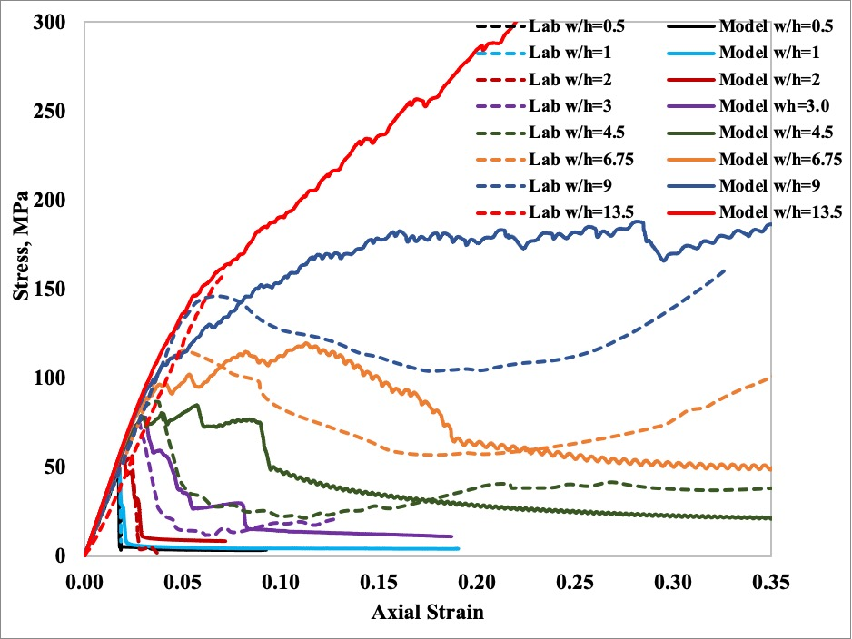
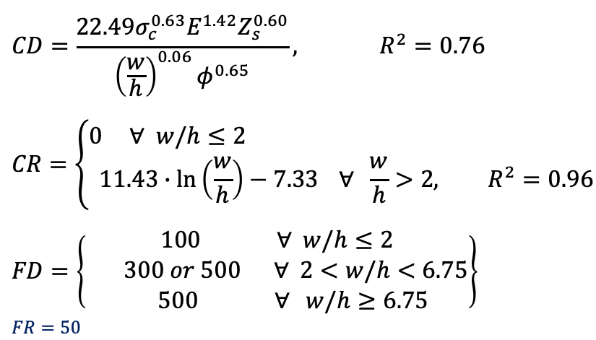
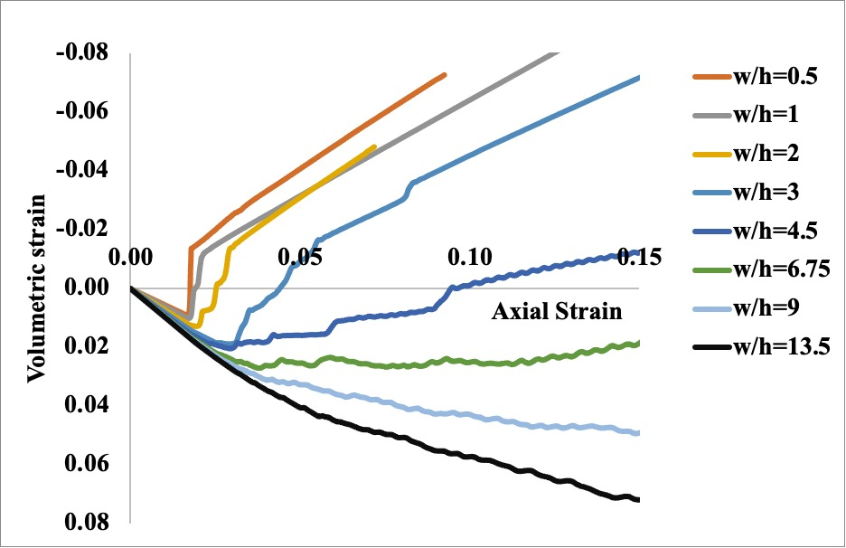
Table Properties of coal seam
Seam | Elastic Modulus (GPa) | UCS (MPa)
Jambad | 2.40 | 40.30
Kargali | 4.00 | 31.00
Kenda | 2.70 | 47.48
Singhpur | 4.87 | 37.40
Uchitdih | 1.82 | 20.00
XII | 2.46 | 19.50

Slide 13
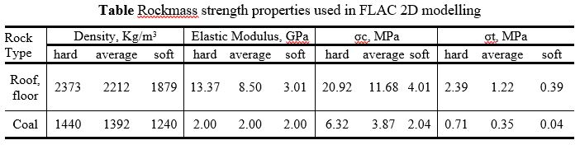
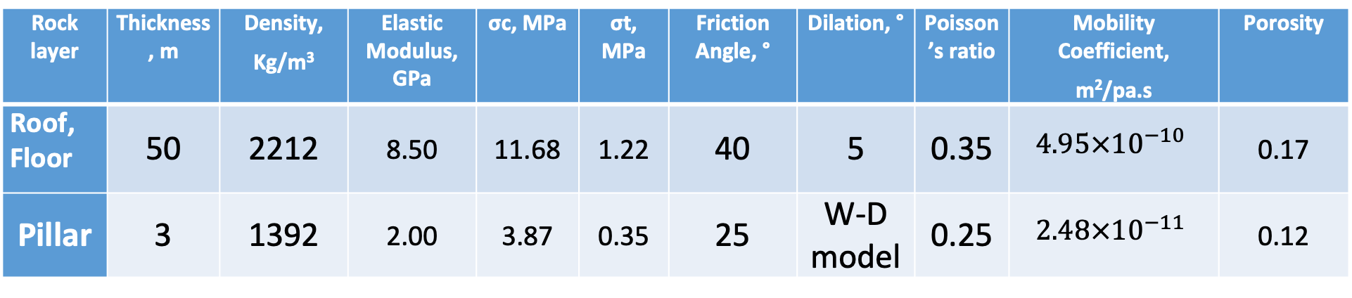
Model Development
Rock layer | Thickness, m | Density, Kg/m³ | Elastic Modulus, GPa | σc, MPa | σt, MPa | Friction Angle, ° | Dilation, ° | Poisson’s ratio | Mobility Coefficient, m²/pa.s | Porosity
Roof, Floor | 50 | 2212 | 8.50 | 11.68 | 1.22 | 40 | 5 | 0.35 | $$4.95×{10}^{−10}$$ | 0.17
Pillar | 3 | 1392 | 2.00 | 3.87 | 0.35 | 25 | W-D model | 0.25 | $$2.48×{10}^{−11}$$ | 0.12
Cover depth = 100–350 m,
Pillar width = 15–120 m,
Water head = 25–100% of cover depth, m
Coal permeability = 0.25-100 mD
Rock permeability = 100-1000 mD

Slide 14
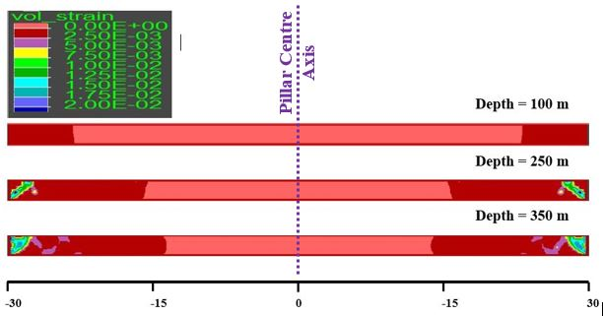
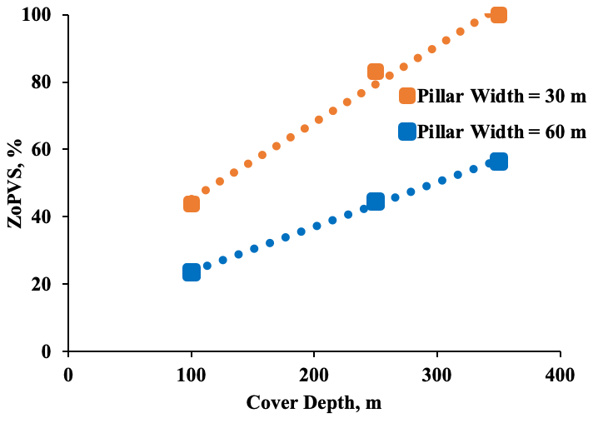
Effect of Cover Depth

Slide 15
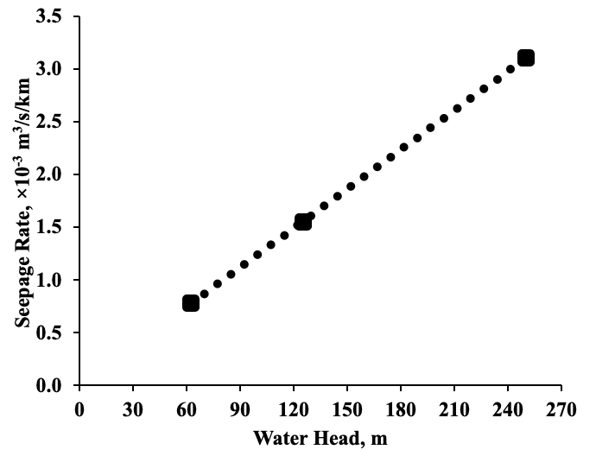
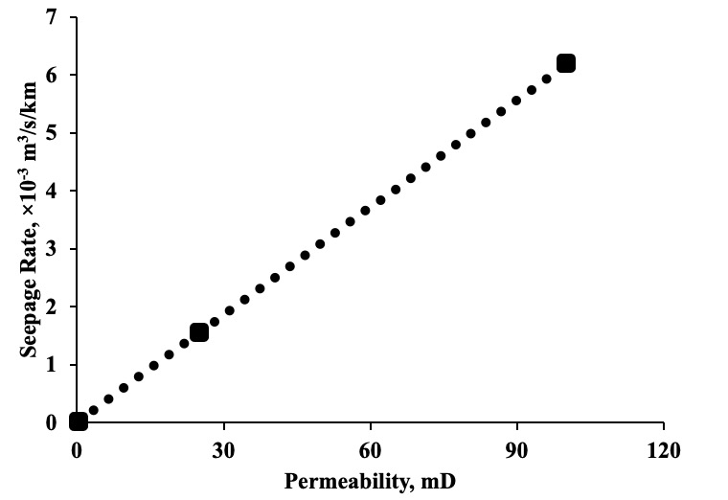
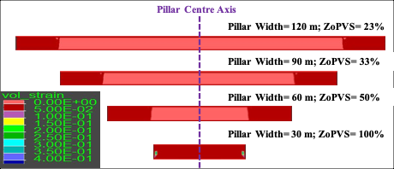
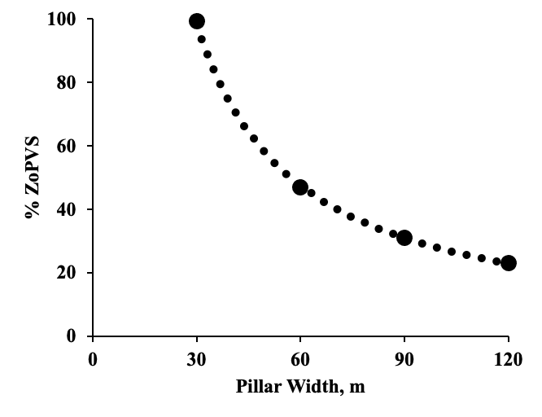
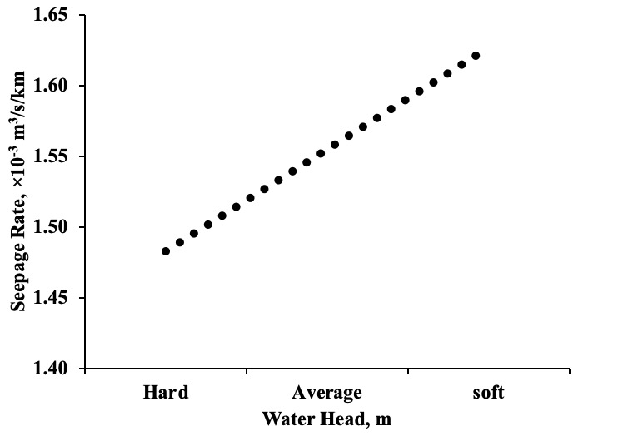
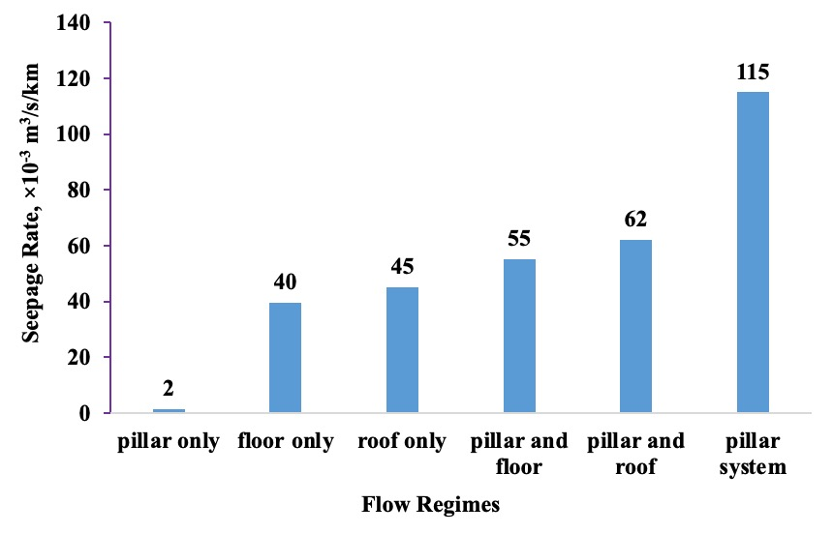
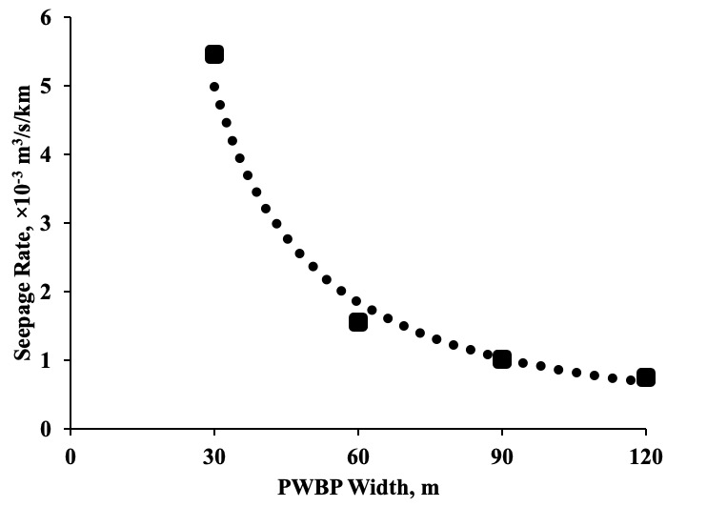
Effect of Pillar Width
Effect of Water Head
Effect of Rock mass permeability
Effect of Strength
Effect of Flow Regime

Slide 16
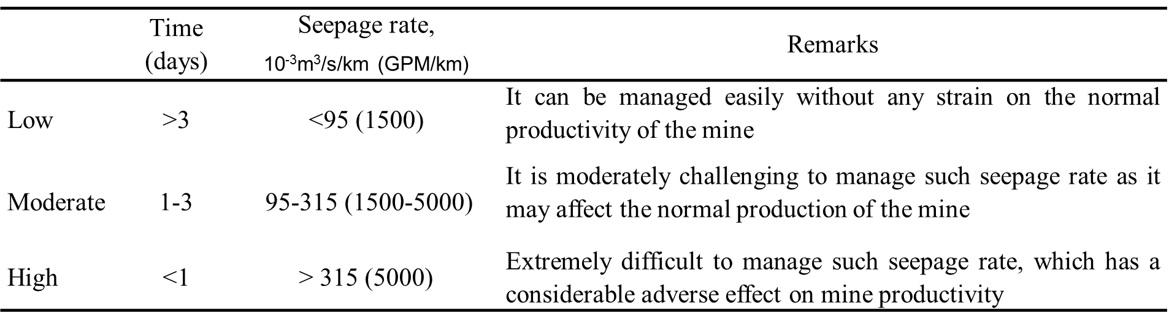
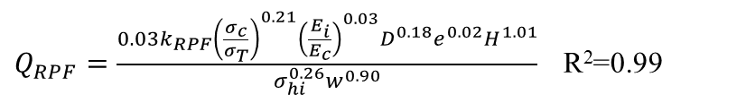
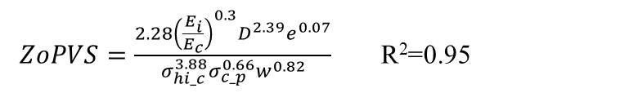
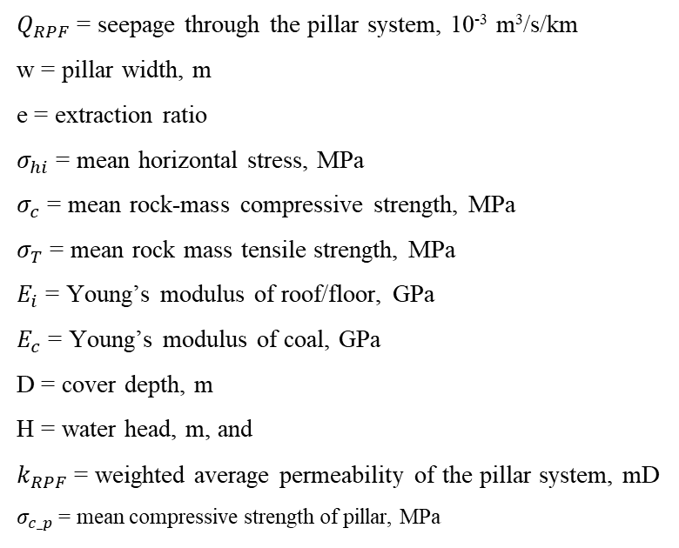
Design Criteria
Governing Equation
$ZoPVS=\frac{2.28{\left(\frac{E_{i}}{E_{c}}\right)}^{0.3}D^{2.39}e^{0.07}}{σ_{hi_c}^{3.88}σ_{c_p}^{0.66}w^{0.82}}$ R²=0.95
Seepage Rate Severity classification
$Q_{RPF}=\frac{0.03k_{RPF}{\left(\frac{σ_{c}}{σ_{T}}\right)}^{0.21}{\left(\frac{E_{i}}{E_{c}}\right)}^{0.03}D^{0.18}e^{0.02}H^{1.01}}{σ_{hi}^{0.26}w^{0.90}}$ R²=0.99
$Q_{RPF}$ = seepage through the pillar system, 10⁻³ m³/s/km
w = pillar width, m
e = extraction ratio
$σ_{hi}$ = mean horizontal stress, MPa
$σ_{c}$ = mean rock-mass compressive strength, MPa
$σ_{T}$ = mean rock mass tensile strength, MPa
$E_{i}$ = Young’s modulus of roof/floor, GPa
$E_{c}$ = Young’s modulus of coal, GPa
D = cover depth, m
H = water head, m, and
$k_{RPF}$ = weighted average permeability of the pillar system, mD
$σ_{c_p}$ = mean compressive strength of pillar, MPa

Slide 17
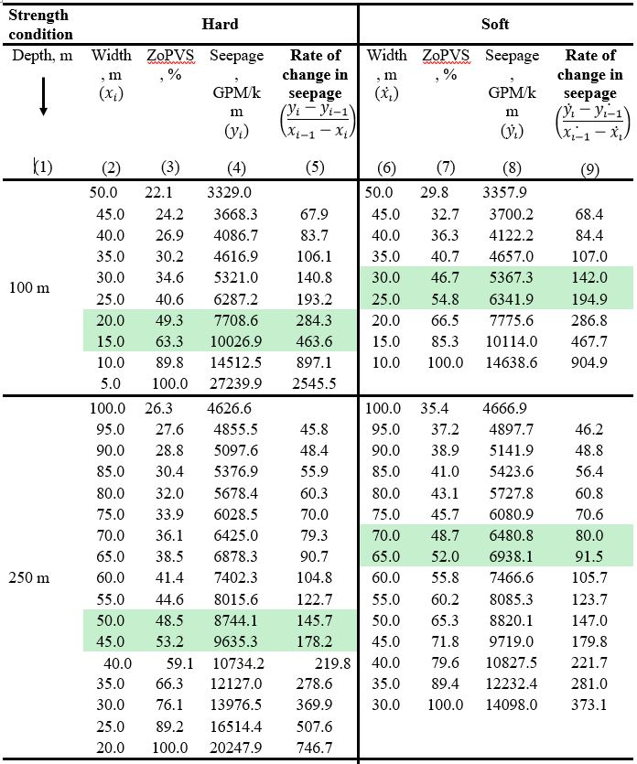
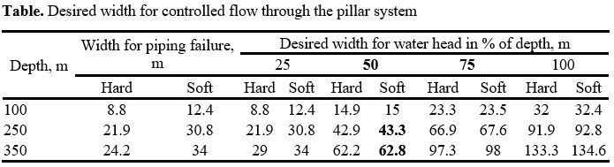
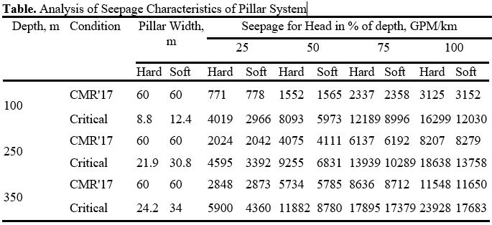
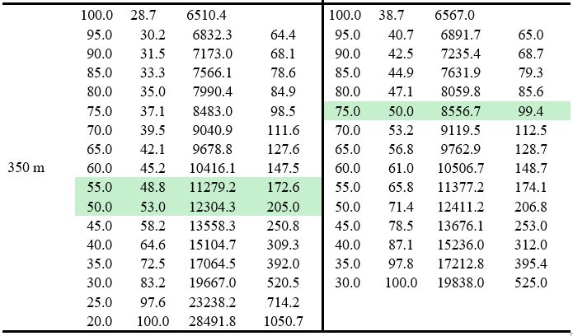

Slide 18
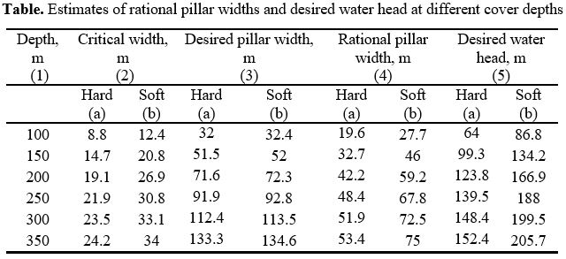
Estimates of rational pillar widths and desired water head
Figure. Seepage and ZoPVS for varying pillar width in hard rock conditions at a cover depth of 100 m for different water heads (WH)

Slide 19

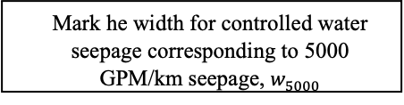


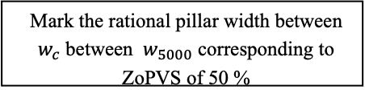
in-situ horizontal stresses of coal, immediate roof and floor
in-situ permeability of coal, immediate roof and floor
modulus of elasticity of immediate roof/floor and coal
compressive and tensile strength of immediate roof/floor and coal
depth of working
extraction ratio
water head
horizontal stress
pillar width
Start
Start
The minimum pillar width for a given geo-mining condition
Select inputs to the design
Obtain the characteristic curve of ZoPVS and rate of water seepage for variable pillar width
Estimate the ZoPVS
ZoPVS < 100 % ?
No
Liable to piping failure
Mark the critical width, considering ZoPVS of 100 %, $w_{c}$
Suggested Approach
Yes
Mark he width for controlled water seepage corresponding to 5000 GPM/km seepage, $w_{5000}$
Estimate the water seepage
Assess the severity of seepage
Mark the rational pillar width between $w_{c}$ between $w_{5000}$ corresponding to ZoPVS of 50 %
Seepage
ZoPVS
Is it ‘Class III’?
The pillar is adequate
No
$$w_{c}$$
$$w_{5000}$$
Obtain the desired water head for Controlled Seepage through rational pillar width
PWBP width
Yes
Pillar size is Inadequate
End

Slide 20
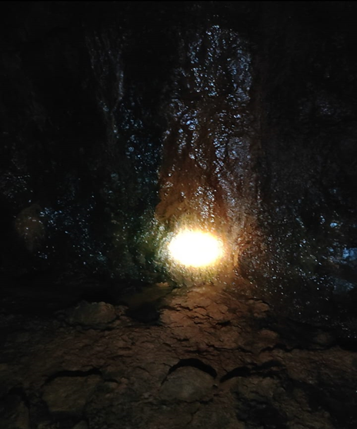

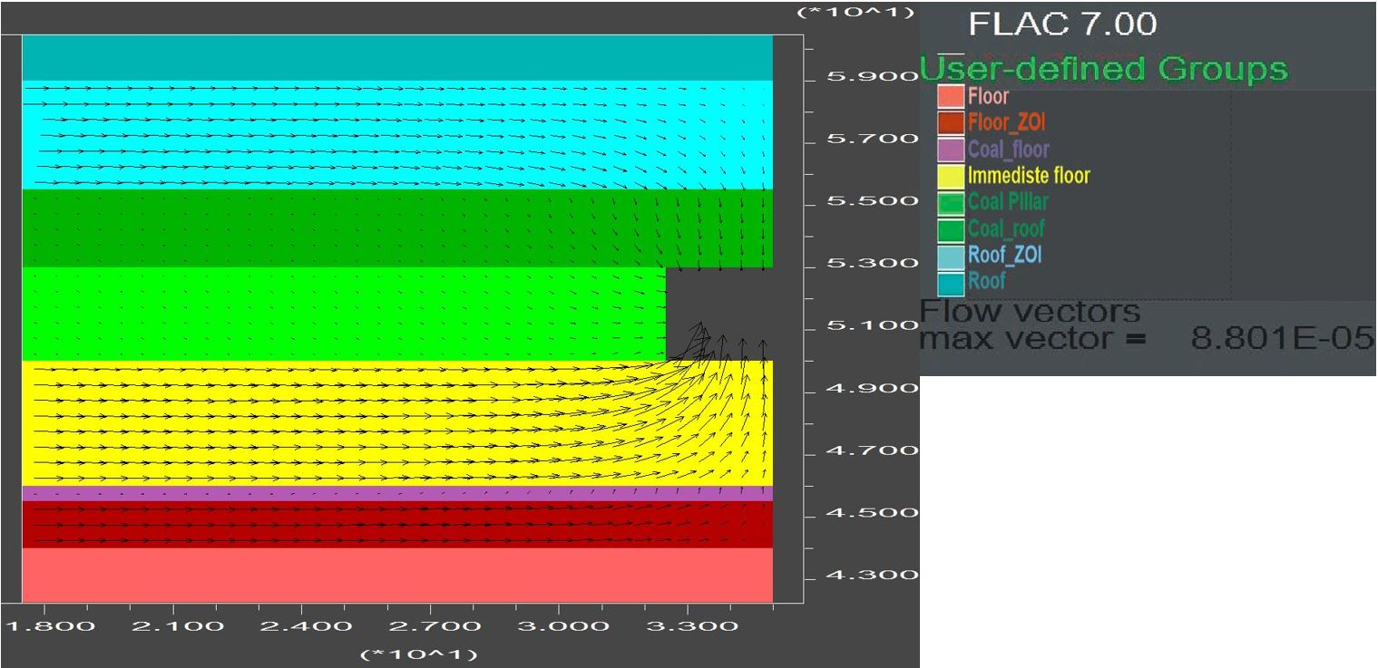
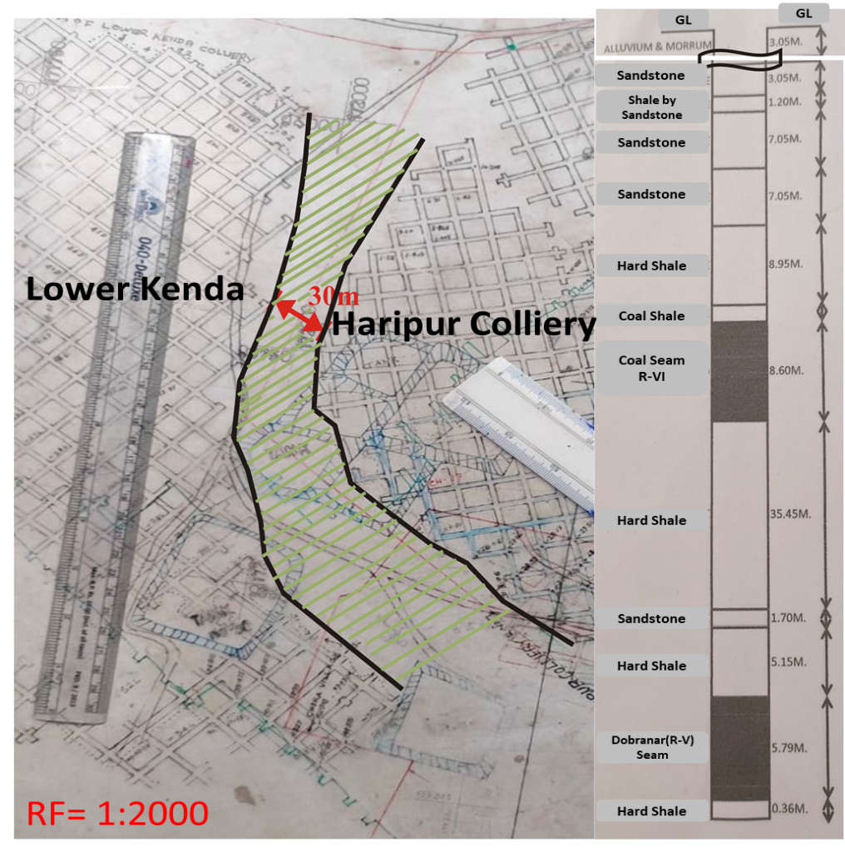
Case Study of Lower Kenda

Slide 21
Discussion
The field data showed that barrier of 200 m width at a cover depth of 18–91 m and 650 m width at cover depth of 78–164 m experienced no seepage. A large amount of coal is locked up in such barriers. On the other hand, the barrier pillar of 10-20m width at 240m depth at Bagdigi mine in Jharia coalfield suffered breach and failed to perform its designed function causing a huge loss. Hence, the design of PWBP needs to be rationalised based on scientific considerations. The issue is critically important for deep mines which are prone to develop large water head on the pillars subjected to very high induced stresses.
Among the prevailing approaches for deciding the size of PWBP, cover depth of working was an unanimously considered parameter. A pillar width of 25-30 m at a cover depth of 100 m and a pillar width of 50m at a cover depth of 350m were the most common estimates. Although existing approaches provide a preliminary design of PWBP, they are unable to project their hydraulic performance for different water heads.
Long term exposure to water leads to a significant loss of strength and deformability of coal measure rocks. In addition to mechanical failure, piping failure resulting from excessive water seepage is also possible wherein the water moving through the rock mass starts eroding the minerals and joint-filling materials, creating voids or channels that weaken the support provided by the pillar. This can lead to the collapse of the pillar and potentially cause inundation and collapse of the roof in the mine.
The in-situ porosity and permeability are low but change significantly with the disturbance and the associated strain. The induced permeability of rock is fracture-driven, and it decreases with the closure of rock fractures but it increases in the plastic softening and residual states of loading induced deformation.

Slide 22
The result of parametric study showed that for increase in cover depth from 100-350m, the pillar of 60m width showed an increase in ZoPVS from 23.5 – 56.4% in the pillar. The increase in extent of failure caused a reduction in the effective width to resist water seepage. The ZoPVS increased more sharply from 43.8% at 100% at 350m depth in the pillar of 30m width as compared to the 60m width. A similar trend was observed in terms of the water seepage rate as well, wherein the seepage rate of 7.6 GPM/km was observed condition at 100 m cover depth, which increased to 29.2 GPM/km at a cover depth of 350m in the ‘pillar only’ condition. These findings agreed with Moeb (1989), underlining the requirement for larger pillar width at higher cover depth.
The ZoPVS increased with reduction in pillar width. Pillars developing 100% ZoPVS marked its piping failure as they were unable to provide a meaningful hydraulic resistance against the imposed water head confirmed by a sharp increase in the seepage rate.
The seepage increased linearly with the permeability. Although the state of stress-dependent volumetric strain induced in the pillar of given remained the same for a given cover depth, the induced permeability was high for the high in-situ permeability of the rock. Therefore, higher seepage was observed through a pillar having higher in-situ permeability.
For pillar width higher than its critical value for piping failure, the induced permeability was higher at the edges only, and the pillar had a significant core in intact condition. However, with a reduction in pillar size to its critical limit, the induced permeability increased significantly, covering the whole width of the pillar, and the intact zone in the pillar reduced to a negligible value. The pillar received the peak vertical stress in the centre during such condition.
The governing equation for ZoPVS considered the modulus ratio of the immediate roof/floor and coal, cover depth, average insitu horizontal stress, uni-axial compressive strength and pillar width to quantify the mechanical damage of a pillar and its effectiveness in controlling the seepage of water. Similarly, the governing equation for the rate of water seepage considered the weighted insitu permeability of the roof, pillar and floor in the MZoI, the strength and modulus ratio of the immediate roof/floor and coal, cover depth, water head and the weighted average insitu horizontal stress to estimate the hydraulic performance of the pillar system. These findings agreed well with the findings reported by Moebs (1989) with regard to the increasing depth of working and the water head and Shen et al. (2012), LaMoreaux et al. (2014) and Liu et al. (2021) with regard to the effect of high in-situ horizontal stresses on the damaged zone and seepage across the barrier under high water heads

Slide 23
The results of water seepage through the regulation mandated pillar width of 60 m vis-à-vis the critical pillar width subjected to water head of 25–100% of the cover depth of 100–350 m in soft and hard strata conditions indicated that the size of PWBP need not be the same for the avoidance of its piping failure, irrespective of the cover depth.
The study of water seepage through the CMR recommended width of 60 m for different cover depths and variable water head showed its reducing trend with a reduction in a water head from 100-25 % at a given cover depth. These results indicated that proactive control of the maximum water head can be helpful in controlling the seepage through a barrier pillar in the mine.
The seepage produced by the 60 m wide pillar was about 37 % less as compared to the maximum allowable seepage for the worst condition of water head at 100 m cover depth. On the other hand, the water seepage through such pillar was above the allowable seepage limit for water head exceeding 188m at cover depth of 250 m and 175 m at cover depth of 350 m. These findings underline the requirement for proper analysis of pumping requirement before the closure of mines.
It is observed that the pillar size for the maximum allowable seepage does not vary significantly with rock strength. However, the critical width is significantly affected by the strength of the rock.
The PWBP width needed to be increased for a controlled seepage under increasing cover depth and water head. The required width varied from 2.6-5.5 times the critical width of 8.8-34 m for the worst possible water head at cover depth of 100-350 m.
PWBP should not only provide safety against the danger of inundation due to its inadvertent failure but should also contribute for effective control of water seepage for avoidance of mine inundation through out the mine life. Accordingly, the rational width of PWBP is decided, corresponding to 50 % of ZoPVS for the critical width. The corresponding seepage rate on the characteristic curve consistently confirmed a controlled seepage of water along with the physical stability of the pillar for its long term acceptable performance.

Slide 24
Conclusion
The existing approach of pillar design suggested the most common pillar width of 25-30 m at a cover depth of 100 m and a pillar width of 50 m at a cover depth of 350 m. However, they are unable to comment on the hydraulic performance of pillars for different water heads and cover depths.
Higher rock mass strength provided only marginal support to the stability of the PWBP as the weakening caused by the water absorption reduced its effective strength drastically in the water-saturated condition. The pillar system produced the worst rate of water seepage rate among the possible flow regimes.
The ZoPVS of 100 % marked critical width of PWBP, which is liable to cause its piping failure and an uncontrolled seepage rate to cause inundation of the mine.
The following table provides the estimates of critical pillar width (A), desired pillar width for controlled seepage rate (B), and rational pillar width (C), along with the corresponding water head for a cover depth of 100-350 m.
Cover Depth, m | Critical width, m | Desired width, m | Rational width, m | Desired water head, m
 | (A) | (B) | (C)
100 | 12.4 | 32.4 | 27.7 | 86.8
150 | 20.8 | 52 | 46 | 134.2
200 | 26.9 | 72.3 | 59.2 | 166.9
250 | 30.8 | 92.8 | 67.8 | 188
300 | 33.1 | 113.5 | 72.5 | 199.5
350 | 34 | 134.6 | 75 | 205.7

Slide 25
The adoption of a 60 m wide pillar as per the prevailing regulatory provision is resulting in avoidable loss of coal at a shallow cover depth of 100 m, but it is unable to contain the water seepage rate within the permissible limit for water head of more than 75 % at 250 m cover depth and 50 % at 350 m depth. The water head needed regulation to 43-60 % to fulfil the requirement of controlled water seepage rate.
The 30 m wide PWBP in Lower Kenda mine at a cover depth of 134.5 m was producing more than the permissible seepage rate owing to unregulated water head in the abandoned mine working, causing periodical flooding and frequent mine closure. These results of ZoPVS and seepage through the pilar corroborated well with the prevailing field condition. The critical, controlled seepage rate, and rational pillar widths were 9.8, 32.4, and 21.8 m, respectively, for this mine.
Adoption of rational pillar width at Lower Kenda mine would require control of the maximum water head to 94 m. The mine needed to enhance its installed pumping capacity by about 600 GPM to avoid the mine flooding during the monsoon period.
The research-based guideline can be helpful in the rational design of new barrier pillars and validate the adequacy of existing barriers against a known water head under a given geo-mining condition.

Slide 26
References
Chen L, Feng X, Xie W, et al (2017) Using a Fluid–Solid Coupled Numerical Simulation to Determine a Suitable Size for Barrier Pillars When Mining Shallow Coal Seams Beneath an Unconsolidated, Confined Aquifer. Mine Water Environ 36:67–77. https://doi.org/10.1007/s10230-016-0404-6
Das MN (1986) Influence of width/height ratio on post-failure behaviour of coal. International Journal of Mining and Geological Engineering 4:79–87. https://doi.org/10.1007/BF01553759
Dash AK, Bhattacharjee RM, Paul PS (2016) Lessons learnt from Indian inundation disasters: An analysis of case studies. International Journal of Disaster Risk Reduction 20:93–102. https://doi.org/10.1016/j.ijdrr.2016.10.013
DGMS (2017) The Coal Mines Regulations 2017
DGMS (2003) Recommendations of Bagdigi Court of inquiry
Durucan S (1981) An investigation into the stress-permeability relationship of coals and flow patterns around working longwall faces. PhD thesis, University of Nottingham
Esterhuizen G, Karacan C (2007) A Methodology for Determining Gob Permeability Distributions and its Application to Reservoir Modeling of Coal Mine Longwalls. 6
Fairhurst CE, Hudson JA (1999) Draft ISRM suggested method for the complete stress-strain curve for intact rock in uniaxial compression. nternational Journal of Rock Mechanics and Mining Sciences & Geomechanics Abstracts 36:279–289
Galav A, Singh GSP, Sharma SK (2021) Design and Performance of Protective Water Barrier Pillars for Underground Coal Mines in India—A Review. J Inst Eng India Ser D 102:539–547. https://doi.org/10.1007/s40033-021-00286-x
Galav A, Singh GSP, Sharma SK (2022) A Numerical Modeling Approach for Assessment of Seepage Characteristics and Performance of Protective Water Barrier Pillars in Underground Coal Mines. Mining, Metallurgy & Exploration 39:2047–2063. https://doi.org/10.1007/s42461-022-00672-3
ITASCA (2011) FLAC, Fast Lagrangian Analysis of Continua. Itasca Consulting Group Inc., US Minneapolis. https://www.itascacg.com/software/FLAC2D. Accessed 20 Oct 2017
Job B (1987) Inrushes at British collieries: 1851 to 1970. Colliery Guardian;(United Kingdom) 235:192–199
Kendorski FS, Bunnell MD (2007) Design and performance of a longwall coal mine water-barrier pillar. West Virginia University, U.S.A., p 7
Kesserü Z (1982) Water Barrier Pillars
Lönnies V (2017) Evaluation of roof-pillar interface and its effect on pillar stability in mine #101. Master Programme in Civil Engineering, Luleå University of Technology

Slide 27
Luo Y, Peng S, Zhang Y (2001) Simulation of water seepage through and stability of coal mine barrier pillars. Transactions of the North American Manufacturing Research Institute of SME Vol. 310:142–147
Meng Z, Shi X, Li G (2016) Deformation, failure and permeability of coal-bearing strata during longwall mining. Engineering Geology 208:69–80. https://doi.org/10.1016/j.enggeo.2016.04.029
Ministry of water resources government of India (2009) Ground water resource estimation methodology, Report of the ground water resource estimation committee. Ministry of water resources government of India, New Delhi, India
MTS (2022) Materials Test Systems. In: MTS. https://www.mts.com/en/products/www.mts.com. Accessed 11 Jul 2022
Prusty B, Pal SK, Kumar JH (2015) Study of porosity and permeability of coal and coal measure rocks from Raniganj coalfield of India. Proceedings of the 24th International Mining Congress of Turkey, IMCET 2015 1024–1033
Rashed G, Peng SS (2015) Change of the mode of failure by interface friction and width-to-height ratio of coal specimens. Journal of Rock Mechanics and Geotechnical Engineering 7:256–265. https://doi.org/10.1016/j.jrmge.2015.03.009
Sheorey PR (1994) A theory for In Situ stresses in isotropic and transverseley isotropic rock. International Journal of Rock Mechanics and Mining Sciences & Geomechanics Abstracts 31:23–34. https://doi.org/10.1016/0148-9062(94)92312-4
Singh GSP (2007) Cavability assessment and support load estimation for longwall workings in India. PhD thesis, I.I.T. (ISM)
Singh RN, Atkins AS (1982) Design considerations for mine workings under accumulations of water. International Journal of Mine Water 1:35–56. https://doi.org/10.1007/BF02504586
Soni AK (2019) Mining of Minerals and Groundwater in India. IntechOpen, London
Walton G, Diederichs MS (2015) A New Model for the Dilation of Brittle Rocks Based on Laboratory Compression Test Data with Separate Treatment of Dilatancy Mobilization and Decay. Geotech Geol Eng 33:661–679. https://doi.org/10.1007/s10706-015-9849-9
Wang F, Liang N, Li G (2019) Damage and Failure Evolution Mechanism for Coal Pillar Dams Affected by Water Immersion in Underground Reservoirs. Geofluids 2019:e2985691. https://doi.org/10.1155/2019/2985691
Whittles DN, Lowndes IS, Kingman SW, et al (2006) Influence of geotechnical factors on gas flow experienced in a UK longwall coal mine panel. International Journal of Rock Mechanics and Mining Sciences 43:369–387. https://doi.org/10.1016/j.ijrmms.2005.07.006
Yang TH, Liu J, Zhu WC, et al (2007) A coupled flow-stress-damage model for groundwater outbursts from an underlying aquifer into mining excavations. International Journal of Rock Mechanics and Mining Sciences 44:87–97. https://doi.org/10.1016/j.ijrmms.2006.04.012
Zhang J, Wang J (2006) Coupled behavior of stress and permeability and its engineering applications. Yanshilixue Yu Gongcheng Xuebao/Chinese Journal of Rock Mechanics and Engineering 25:1981–1989
Zhang Y, Li F (2022) Prediction of Water Inrush from Coal Seam Floors Based on the Effective Barrier Thickness. Mine Water Environ 41:168–175. https://doi.org/10.1007/s10230-022-00846-x
Zhao J, Konietzky H, Herbst M, Morgenstern R (2021) Numerical simulation of flooding induced uplift for abandoned coal mines: simulation schemes and parameter sensitivity. Int J Coal Sci Technol 8:1238–1249. https://doi.org/10.1007/s40789-021-00465-x
Zhu H, Zhao X, Guo J, et al (2015) Coupled flow-stress-damage simulation of deviated-wellbore fracturing in hard-rock. Journal of Natural Gas Science and Engineering C:711–724. https://doi.org/10.1016/j.jngse.2015.07.007

Slide 28
Thank You

